Slide 1



Slide 2

Welcome
Presented By:
Refazul Hoque Priyom Samia Nasrin Sifat Nur Momo
Id: 2104010202267 Id: 2104010202259 ID: 2104010202282

Slide 3


Slide 4
ECONSCIOUS
A new way to manage Post Consumer Plastic waste through Collection.
RECYLCING the waste
Produce new products
Sell the products

Slide 5
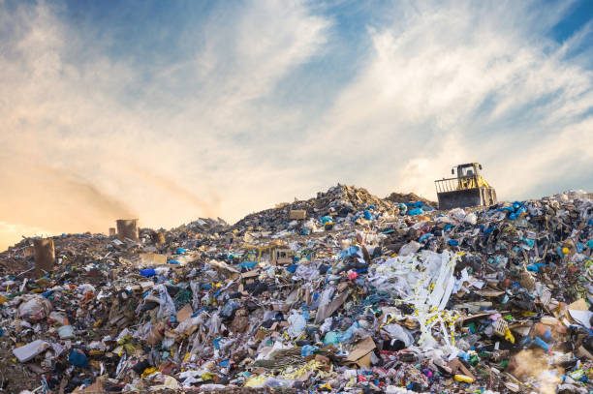
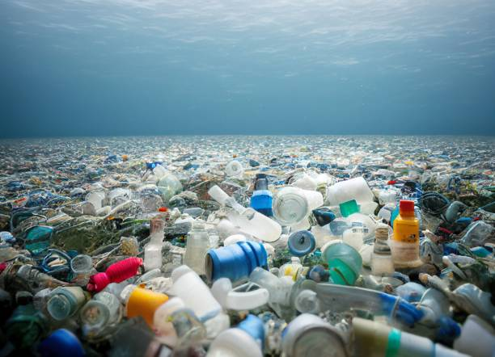
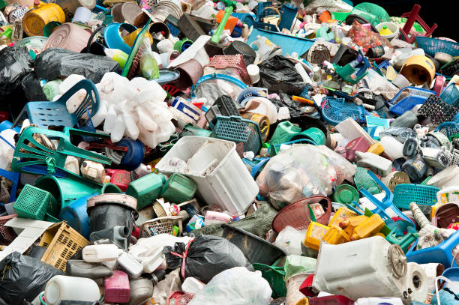
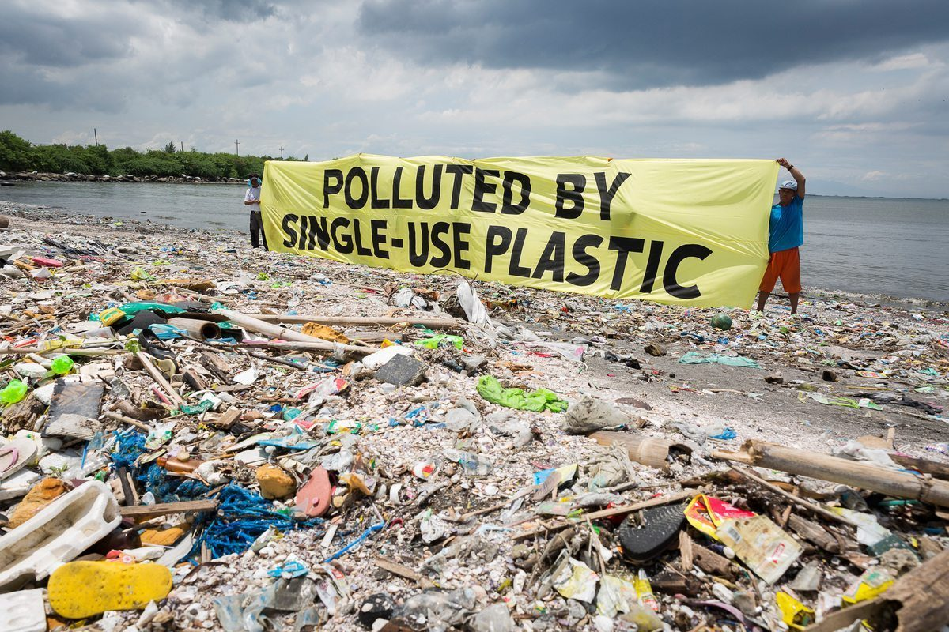

Slide 6
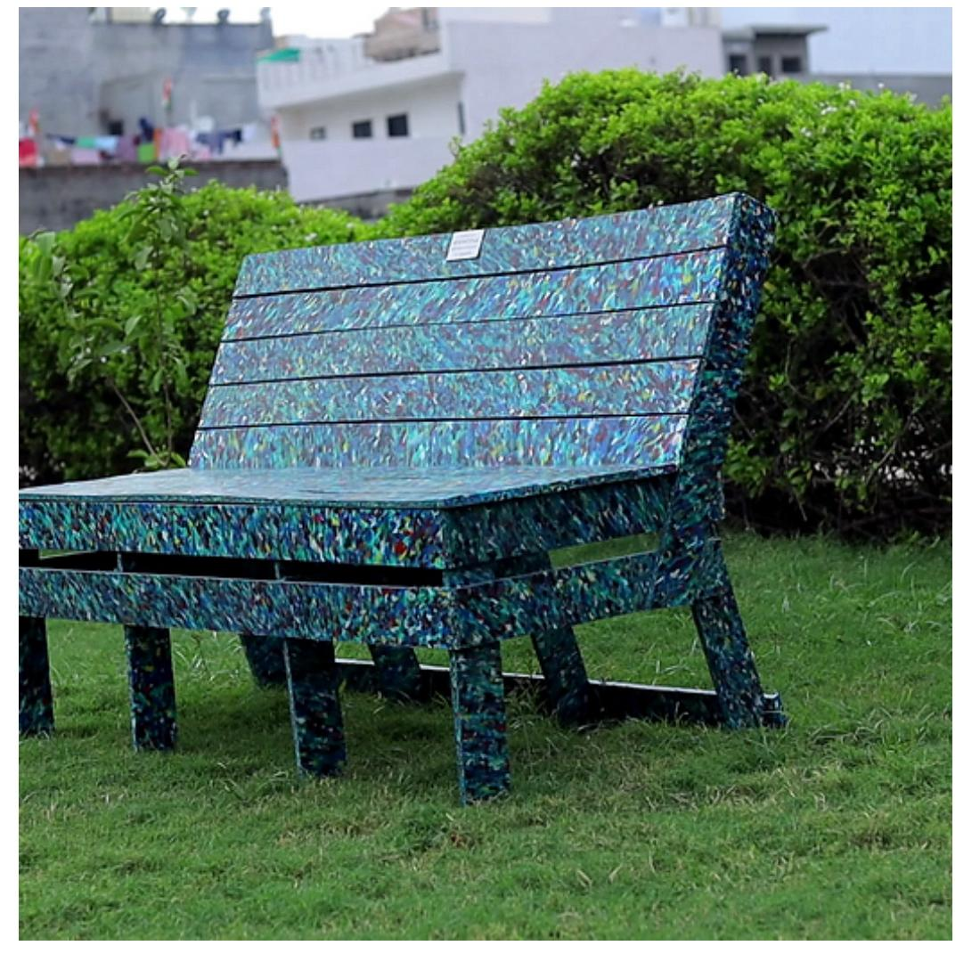
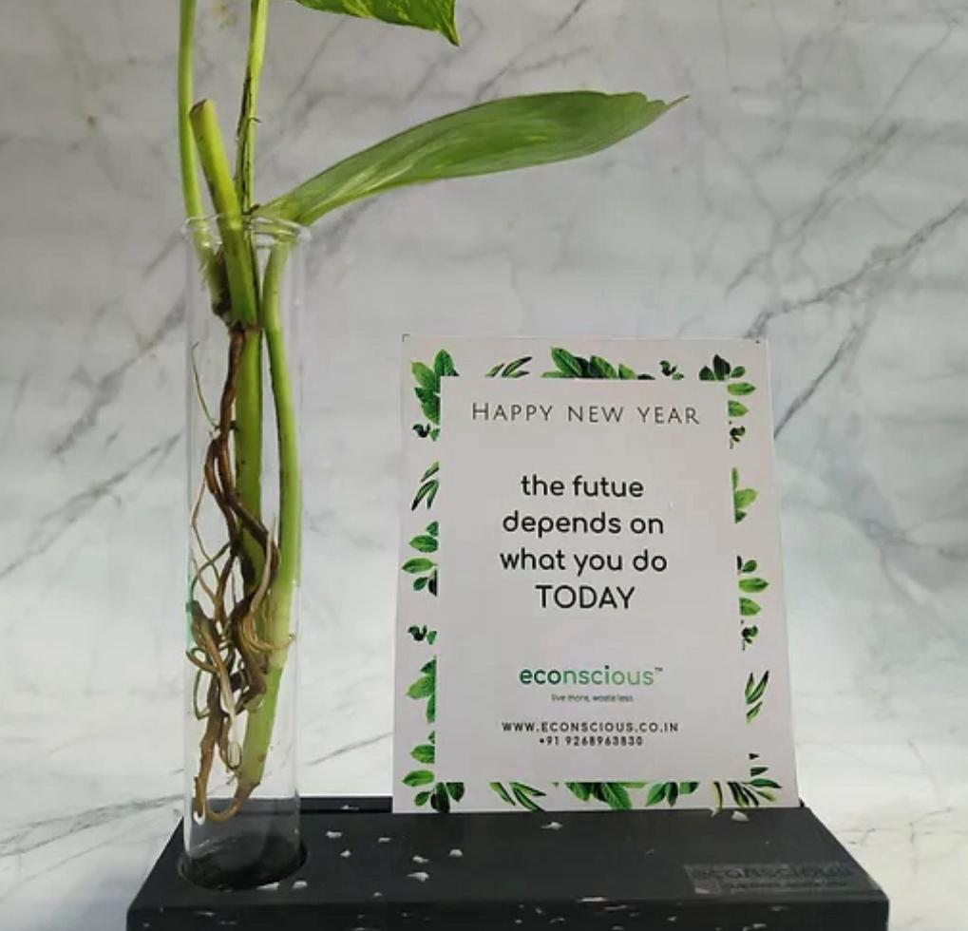
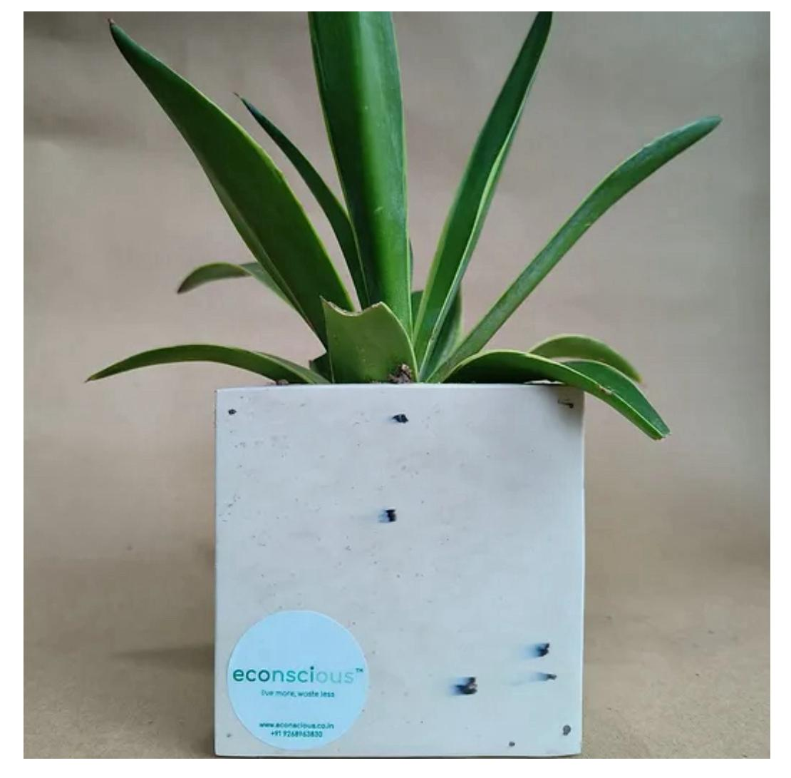
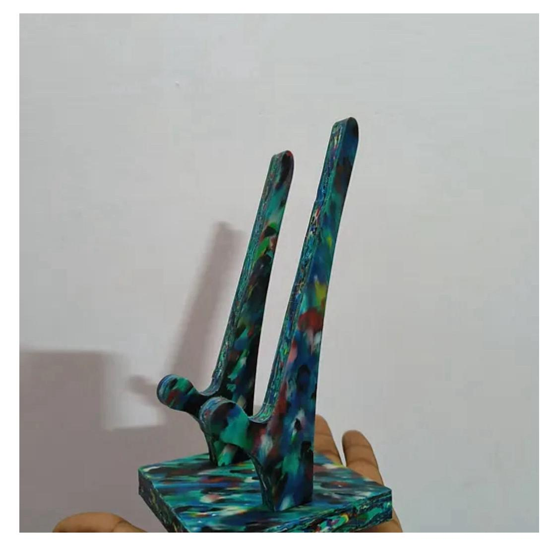
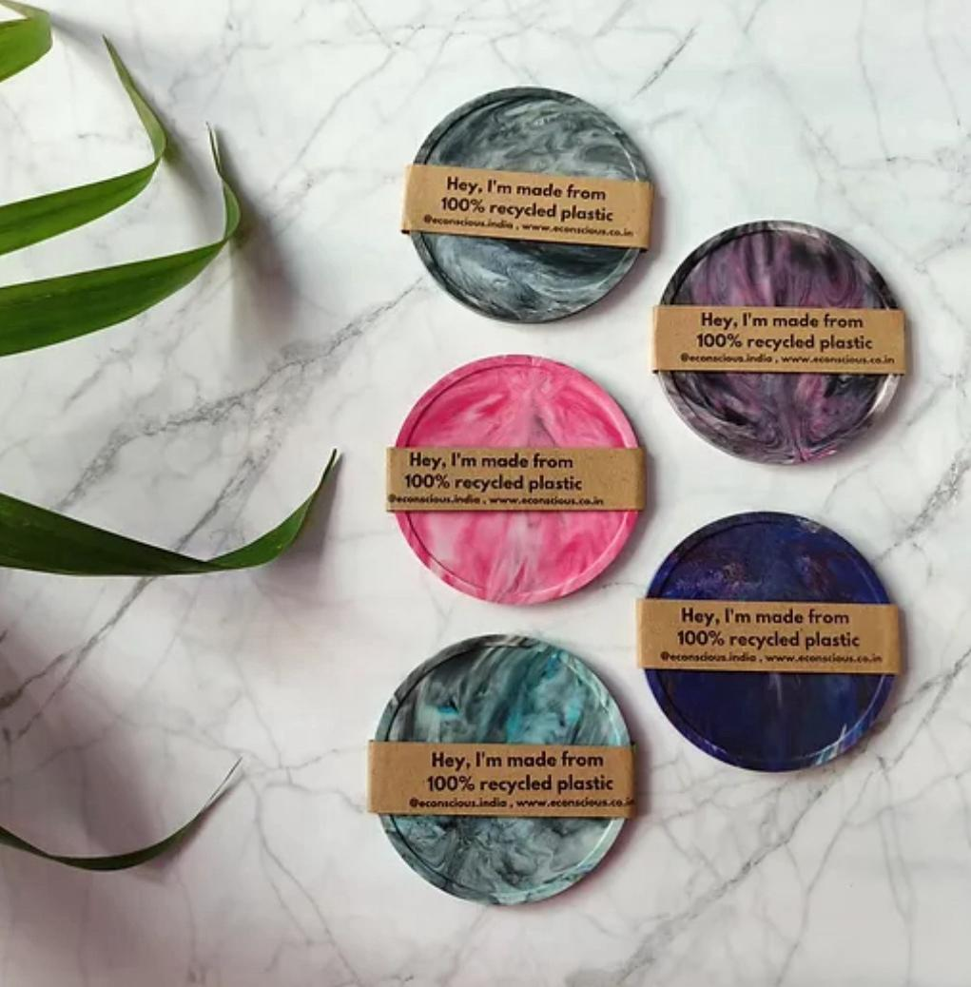

Slide 7

Purpose
Promote Sustainable Living
Reduce Plastic Waste
Convenient and Secure Shopping
Measure and Demonstrate Impact
Host Sustainability Initiatives

Slide 8
Benefits of Econscious
Environmental Stewardship
Circular Economy Champion
Streamlined Shopping Experience
Product Catalog Accessibility
Community Engagement
Transparency and Traceability
Notification and Updates
Secure Transaction
Integration with Social Media
Promotional Campaigns

Slide 9
Features
Signup after admin approval
User Profiles
User Account Management
Push Notifications
Product Reviews and Ratings
Cart
User Feedback Mechanism
Order Tracking
Simple to contact with the admin
Live Chat

Slide 10
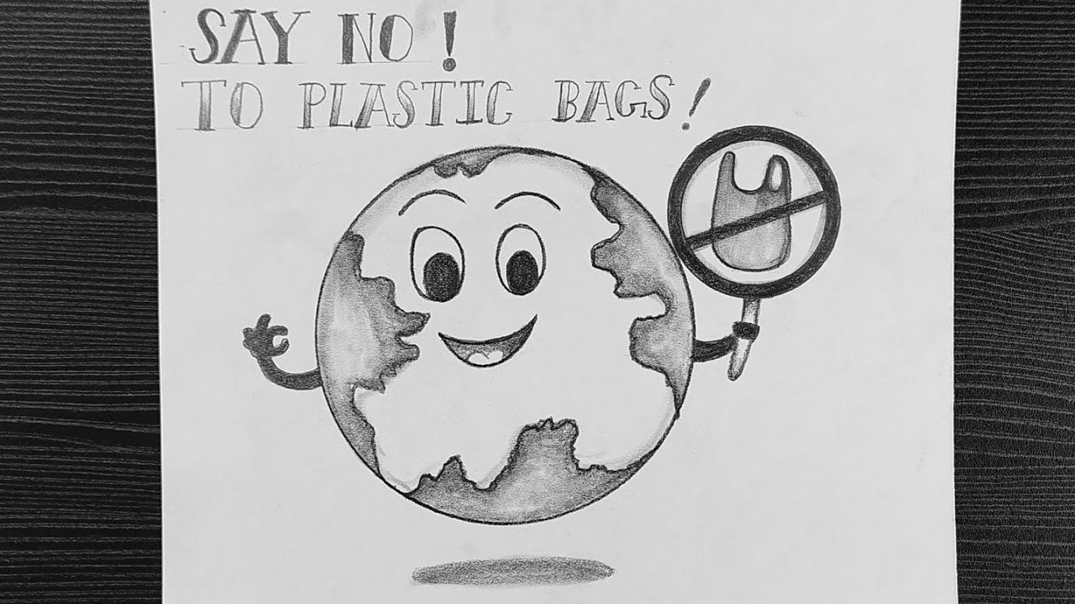
THANK YOU

